Slide 1
CenterPoint Energy
2020 Natural Gas Transmission Pipeline Replacement Project
St. Louis Park: Texas Avenue S., Cedar Lake Road and Virginia Avenue S. between Wayzata and Minnetonka Boulevards
May 6, 2020

Slide 2
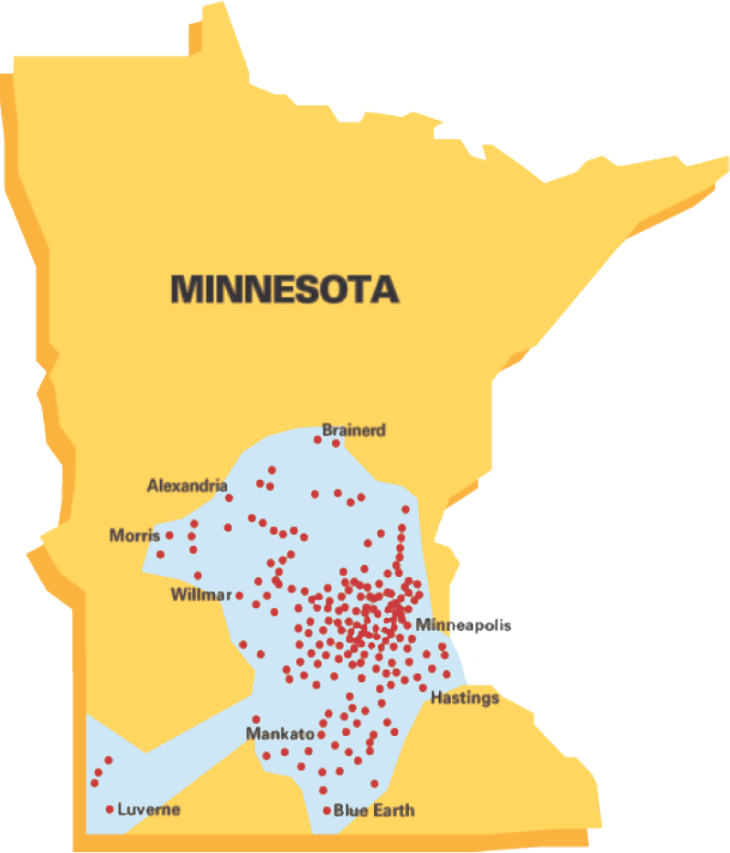
CenterPoint Energy - Minnesota Gas Operations
Minnesota Based
Founded in 1870
806,000 customers
260 communities
1,300 employees
$1.3 billion in infrastructure
13,548 miles of gas pipeline

Slide 3
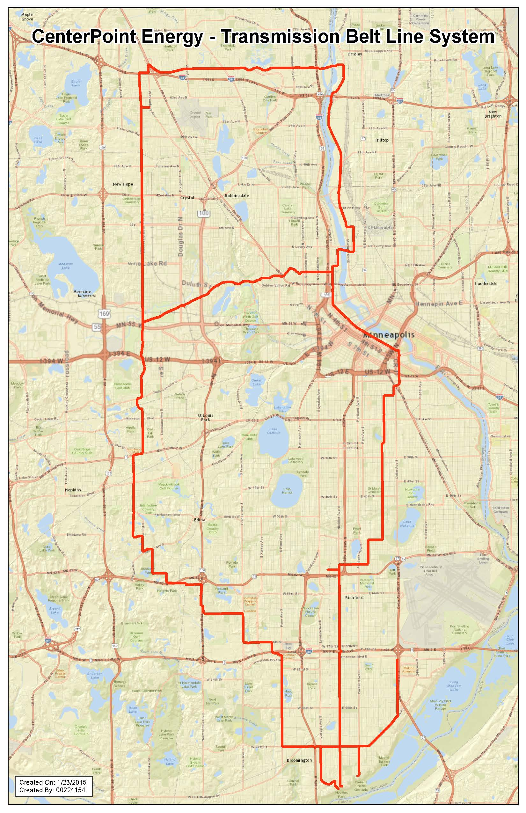
Minnesota Belt Line
Approximately 74-mile system of 20 and 24-inch diameter steel pipe.
Multi-year project to upgrade and rehabilitate approximately 61 miles of the system.
This project will enhance long-term safety, reliability, and better facilitate ongoing inspection of pipeline.
Construction activity in 2020 will include Golden Valley, Edina, Crystal, New Hope and St. Louis Park.

Slide 4
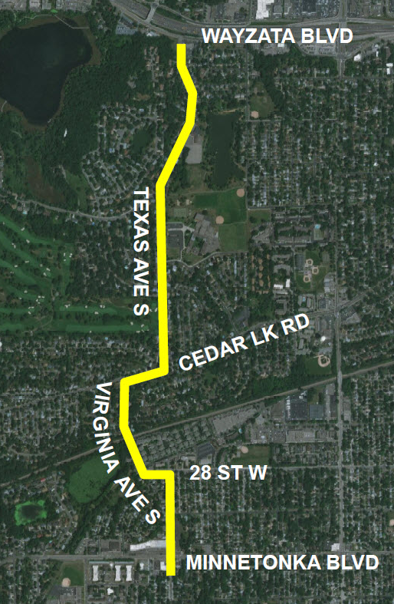
2020 Belt Line Project – St. Louis Park
In 2020 we will replace approximately 1.5 miles of 24-inch steel transmission pipe in the public-right-of-way along the route highlighted.
Work will occur on the roadway in most areas of the project and require traffic detours and traffic barriers to protect the public and workers. Our Construction Zone website will be updated regularly.
Our contractor will work from spring to fall. Work will be coordinated with other construction activity and public safety priorities.

Slide 5
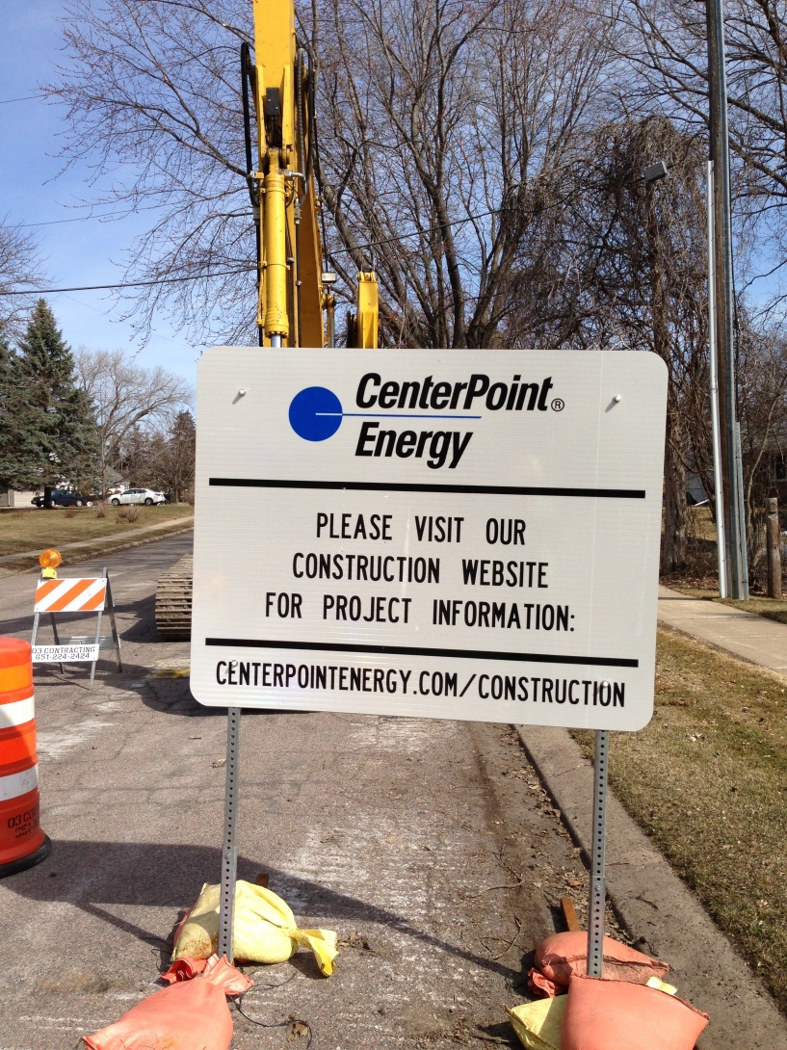
Contact Information for Construction Questions
For questions about this project, please go to:
  Communication Specialist:
    612-321-5546
  Information Hotline:
    612-321-5329
    csv.constructionservices@centerpoint energy.com
  Restoration Inquiries:
    612-321-5042
    csv.restoration@centerpointenergy.com
Text-to-subscribe for updates regarding the 2020 St. Louis Park Belt Line Project in
St. Louis Park by sending
CNP TEXASAVES to GOV311 (468311).
Thank you for your patience while construction is taking place. This work is part of CenterPoint Energy’s ongoing commitment to ensure the safe and reliable delivery of natural gas now and into the future.

Slide 6
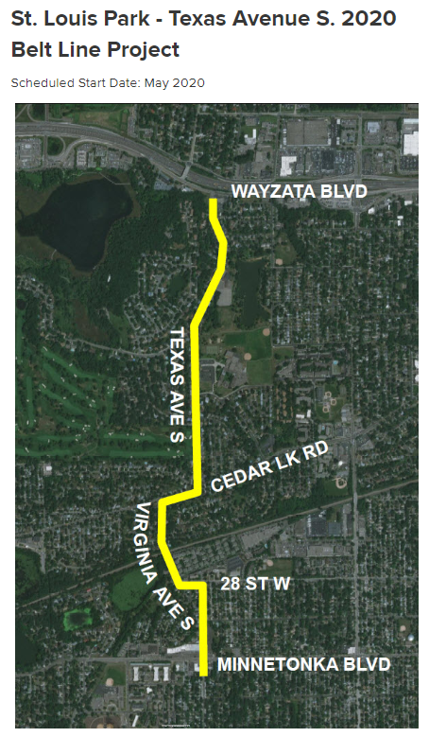
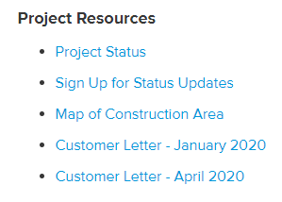
Committed to Providing Readily Available
Contact Information and Ongoing Construction Updates
To view weekly updates, check out our Project Status page and Sign Up for Status Updates link via our CenterPoint Energy Website at www.centerpointenergy.com/construction.

Slide 7
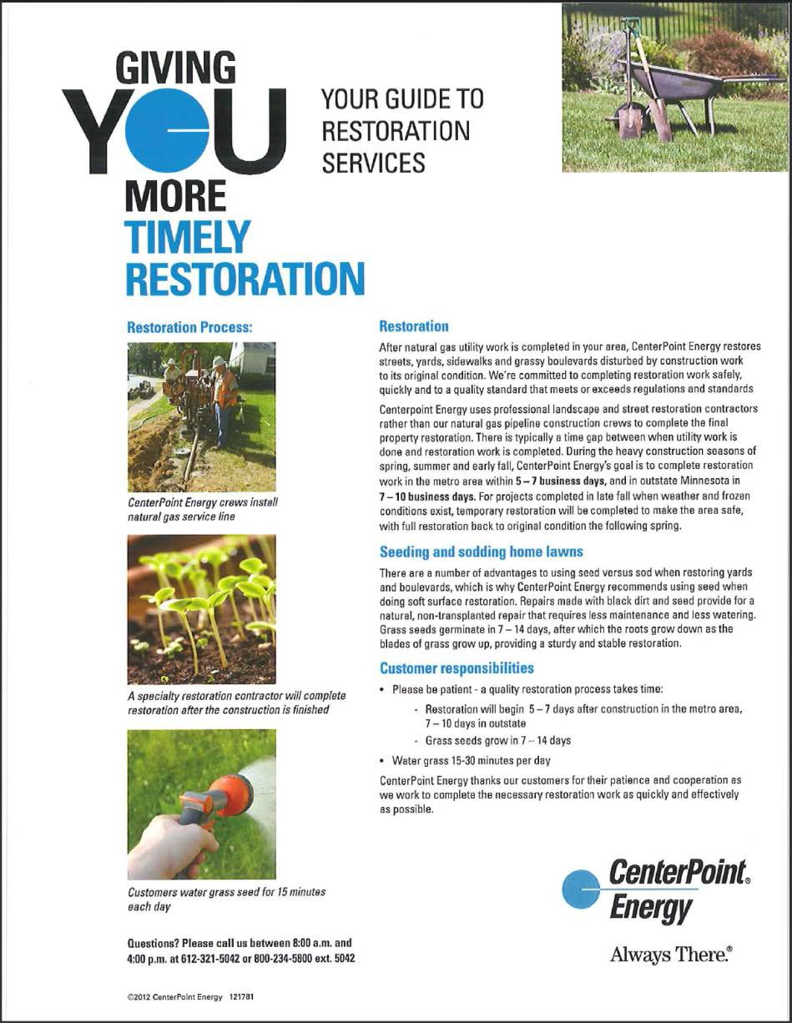
Road, Sidewalk and Grassy Area Restoration
After construction, restoration will be done to:
Streets
Sidewalks
Boulevards
Lawns
Areas disturbed by CenterPoint Energy’s construction will be restored to original condition.
Restoration is typically started within five to seven business days after construction is completed.

Slide 8
In Closing
Replacing aging infrastructure is an important but difficult task.
➢We apologize for the inconvenience and appreciate your patience.
➢ Please continue to patronize local area businesses. They will be open and accessible during construction.
➢We will restore all property disturbed by CenterPoint Energy’s construction.

