Slide 1
CenterPoint Energy
Lakeville – Ipava Avenue 2022
February 2022

Slide 2
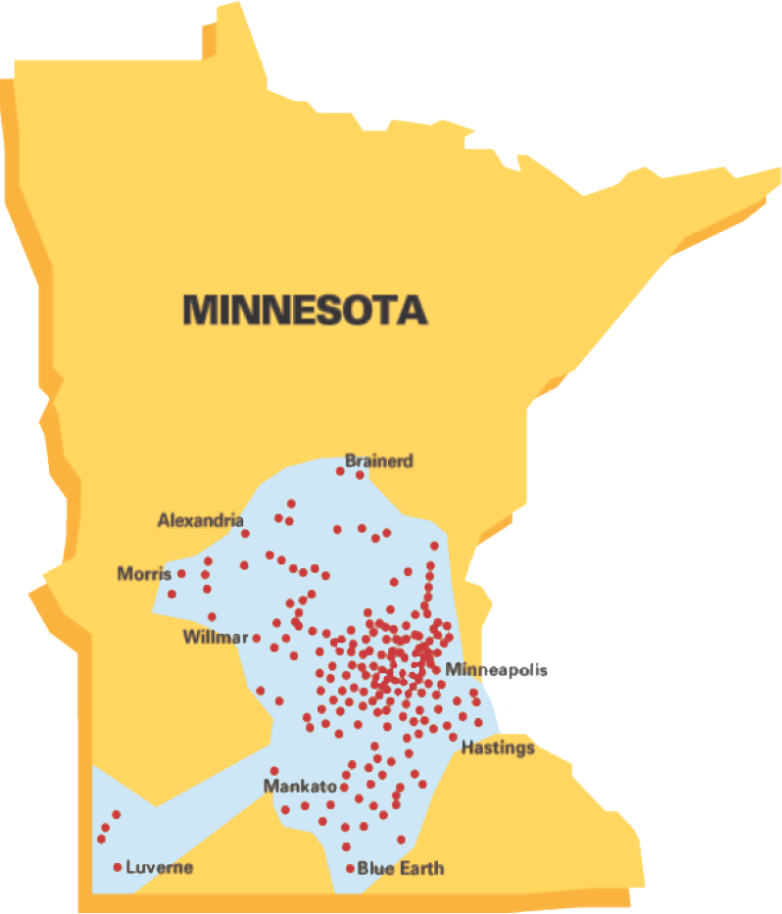
CenterPoint Energy – Minnesota Gas Operations
Founded in 1870
870,000+ customers
Serving 260+ communities
1,200 employees
Invested $1+ billion in infrastructure since 2013, with plans to invest additional $1 billion in next 5 years
14,000 miles of pipeline

Slide 3
CenterPoint Energy – Lakeville Line
Primary feed to CenterPoint Energy’s southern distribution system.
Serves Lakeville, Burnsville, and other South Metro suburban areas.
Installation began in 1939.
Replacement is part of current plan for upgrading natural gas pipeline system.
Anticipated timeline of construction from spring to fall 2022.
Notes:
2/22/2022
3

Slide 4
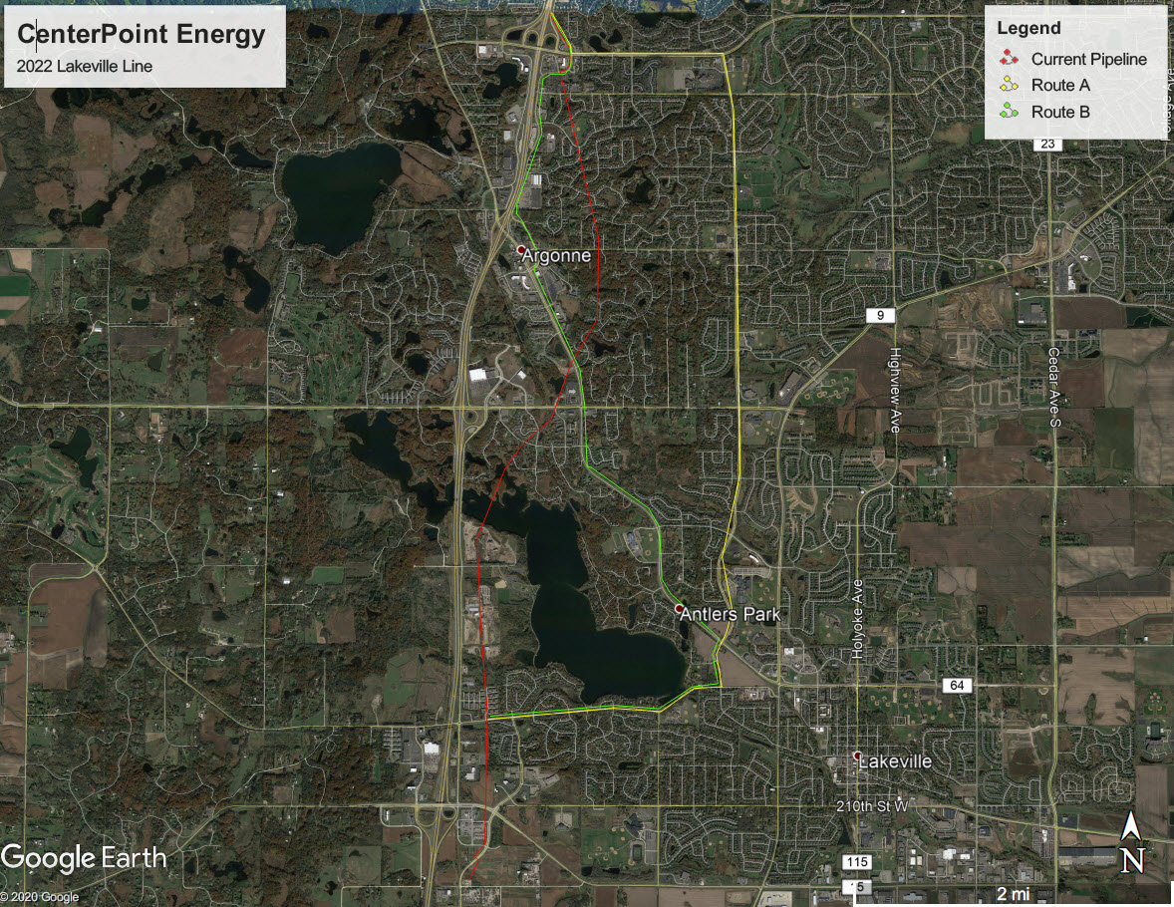
CenterPoint Energy – Lakeville Line Routes

Slide 5
CenterPoint Energy – Lakeville Line Routes
Pipeline route considerations for selection
Existing Route
  The current pipeline corridor has been developed with many residential side and back yards making the open trench replacement very disruptive.
  Due to the many bends in the alignment, a trenchless installation would have similar impacts due to need of pipe stringing area.
Route B, Co. Rd. 50 & Kenrick Ave. Frontage Rd
  Frontage Rd section narrow with business and transit locations having direct access.
  High speed limit on Co Rd 50 requires longer traffic control setups for safety.
  Traffic detour would be from Dodd to 185th or 215th, longer detour routes.
Route A, Ipava Ave. & 165th Street W.
  Available corridor out of roadway for majority of route.
  Several major cross streets to break up traffic control.
  Minimal direct access points (driveways & parking lots) make local access easier.

Slide 6
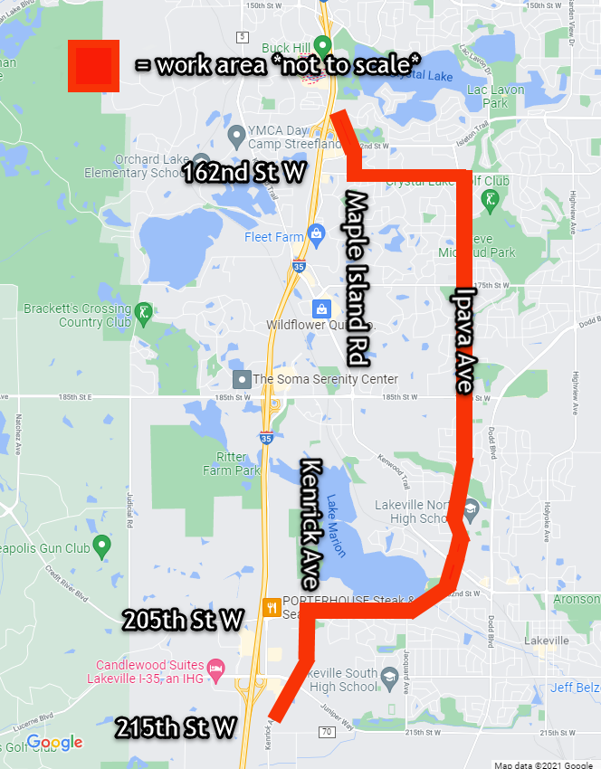
Lakeville – Ipava Avenue 2022
From spring to fall 2022, CenterPoint Energy’s authorized contractors will work in Lakeville along these streets:
Maple Island Road from Buck Hill to 162nd Street W.
165th Street W. from Maple Island Road to Ipava Avenue
Ipava Avenue from 165th Street W. to 202nd Street W.
202nd Street W. and 205th Street W. from Ipava Avenue to Kenrick Avenue
Kenrick Avenue from 205th Street W. to 215th Street W.

Slide 7
Anticipated Traffic Impacts
Open trench excavation
Varying time spent on each block
Public tree removals along Ipava Avenue
Construction on a few blocks at a time, varying from lane shifts to full closures.
Access maintained for residents and businesses
Restoration following closely behind pipe replacement crew

Slide 8
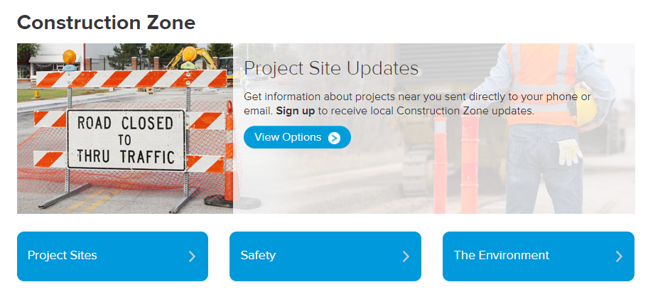
How can I get construction updates?
Go to CenterPointEnergy.com/Construction.
Click on “Project Sites” and select the project’s name.
On the project’s page, check out our Project Updates link.
Click our Sign Up for Updates for email or text message updates.

Slide 9
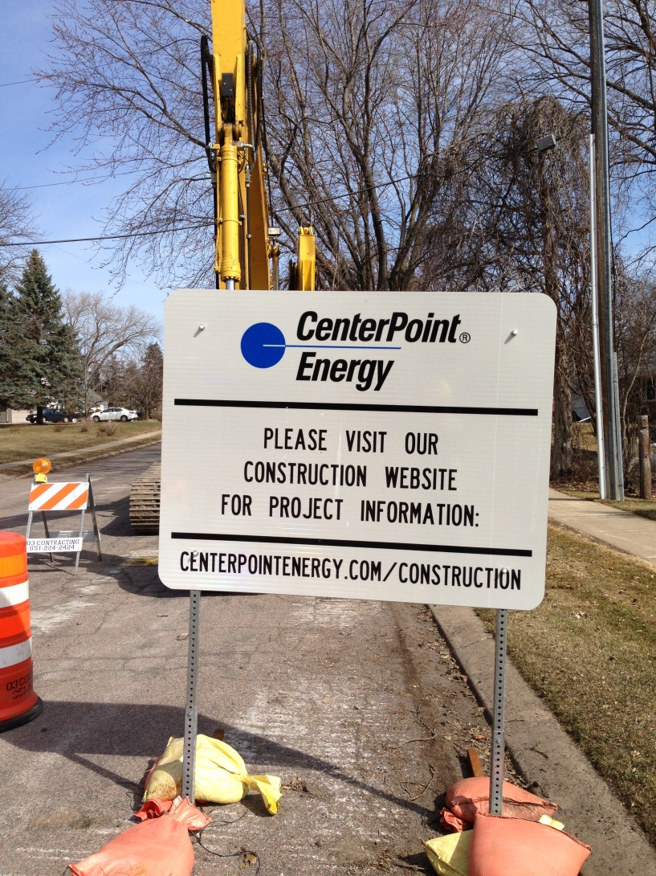
How can I contact CenterPoint Energy?
CenterPointEnergy.com/Construction
Construction questions:
  hannah.gullickson@ centerpointenergy.com
  612-321-5546
Restoration questions:
  csv.restoration@
  centerpointenergy.com
  612-321-5477
All other questions:
  csv.constructionservices@centerpointenergy.com
  612-321-5369

Slide 10
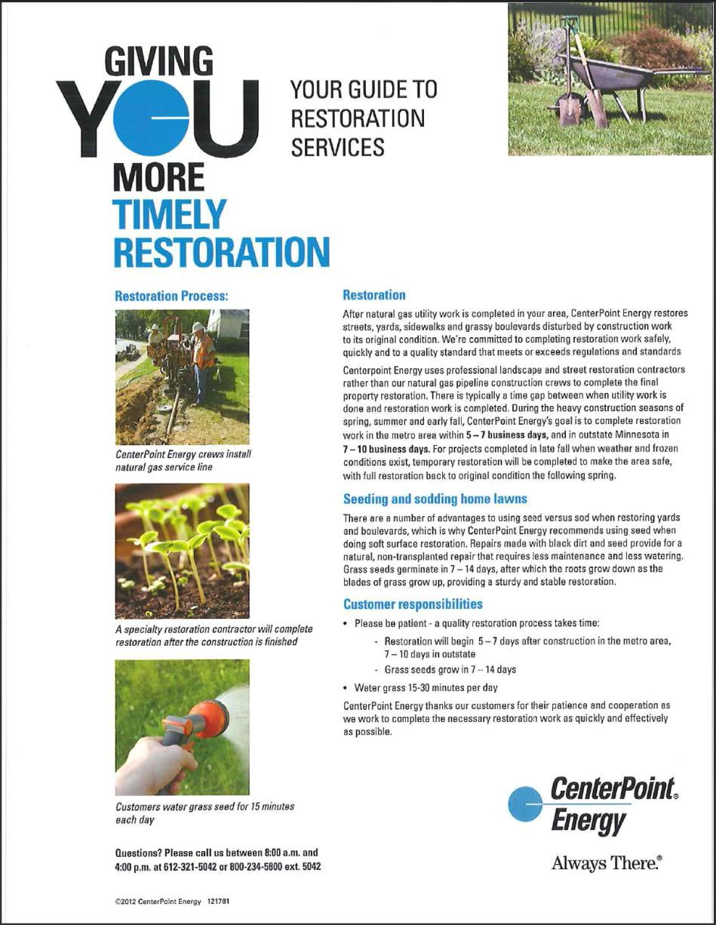
What should I expect for restoration?
After construction, restoration will be done to:
  Streets
  Sidewalks
  Boulevards
  Lawns
Areas disturbed by CenterPoint Energy’s construction will be restored to original condition.

Slide 11
In Closing
Thank you for your patience while construction is taking place. Replacing aging infrastructure is an important but difficult task.
This work is part of CenterPoint Energy’s ongoing commitment to ensure the safe and reliable delivery of natural gas now and into the future.
Please continue to patronize local area businesses. They will be open and accessible during construction.
Notes:
2/22/2022
11

