Slide 1
CenterPoint Energy
Minneapolis – Kenny Neighborhood
March 17, 2022

Slide 2
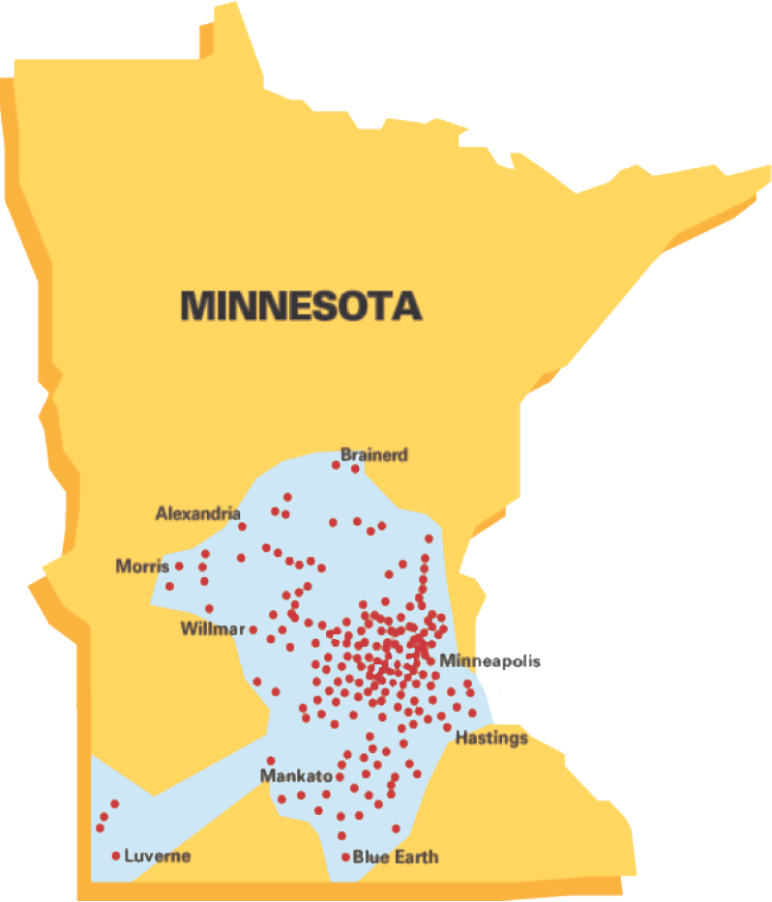
CenterPoint Energy – Minnesota Gas Operations
Founded in 1870
Serving 900,000+ customers
1,200 employees
Invested $1+ billion in infrastructure since 2013, with plans to invest additional $1 billion in next 5 years
14,000 miles of pipeline

Slide 3
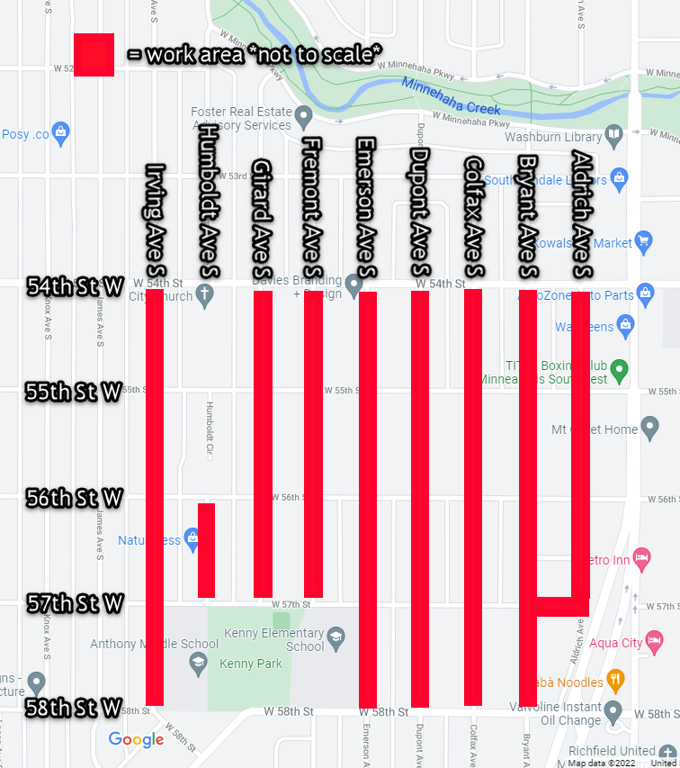
Minneapolis – Kenny Neighborhood
From spring to fall 2022, CenterPoint Energy’s authorized contractors will work in the Kenny Neighborhood.
Technician will make appointment with resident to move inside meter to outside of resident’s home.
Meter move takes approx. 2 to 3 hours.
Inside homes, technicians will wear masks.
After natural gas work is complete, technician will relight resident’s pilot lights.

Slide 4
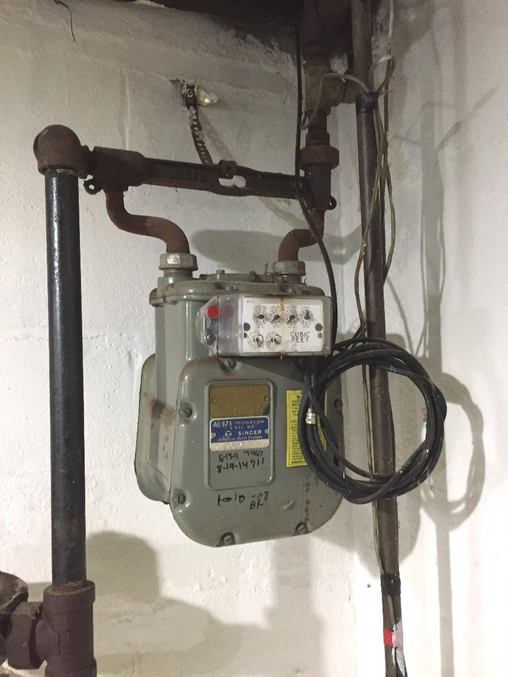
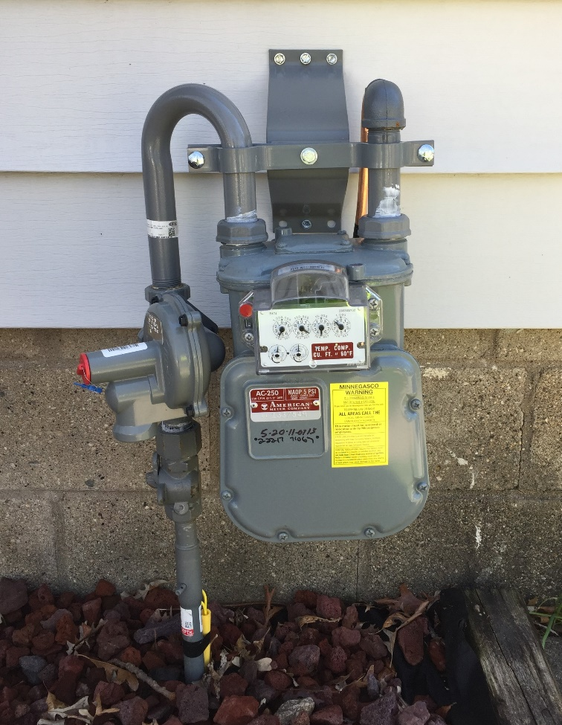
Inside-to-outside meter move

Slide 5
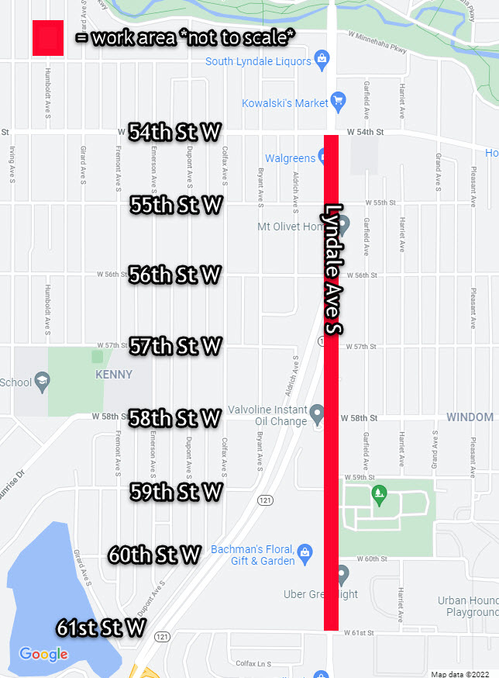
Minneapolis – Lyndale Avenue S.
From April to fall 2022, CenterPoint Energy’s authorized contractors will work on Lyndale Avenue S.
Crews will replace two natural gas mains, connect service lines to first main, move inside meters outside, and restore disturbed areas.
Lane shifts, parking restrictions, and a sidewalk closure
Closure from 56th to 58th St. W.
Temporary restoration in between some of the crews’ work

Slide 6
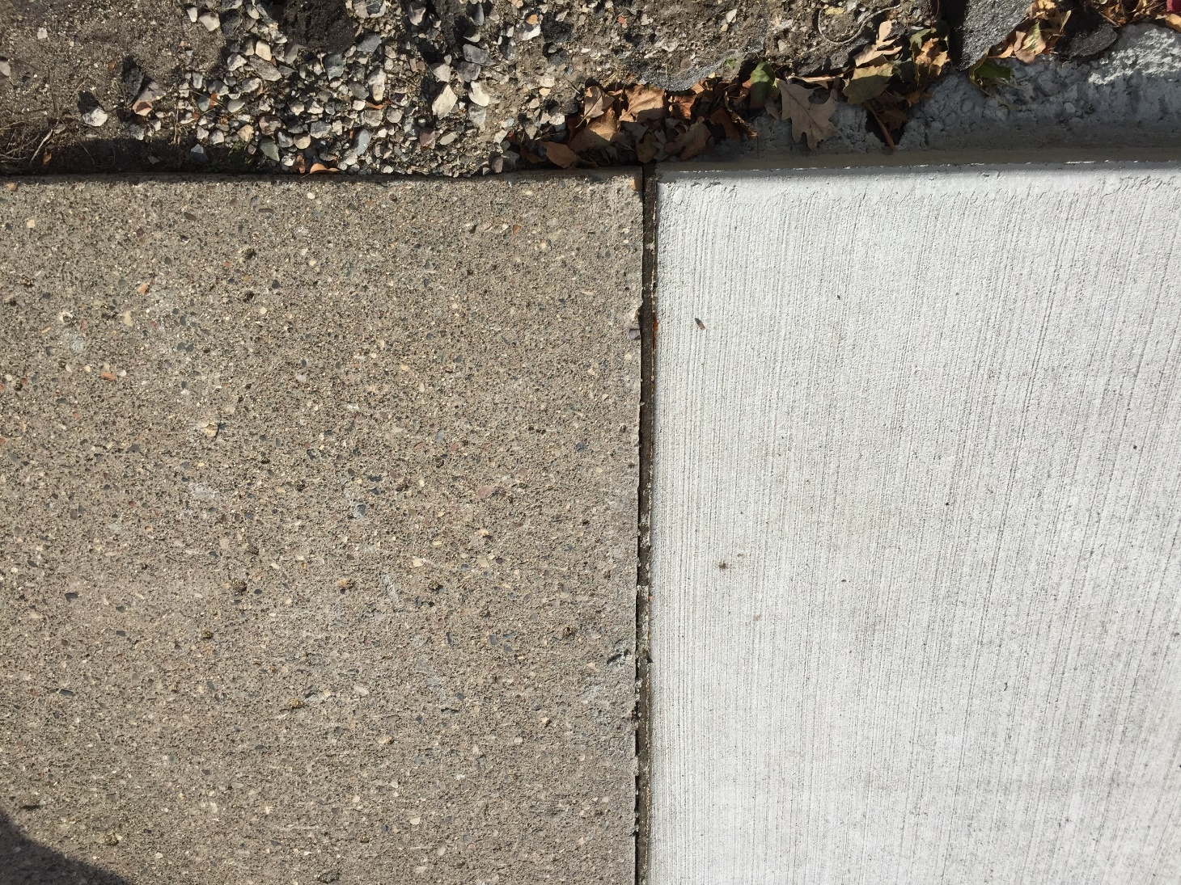

Restoration

Slide 7
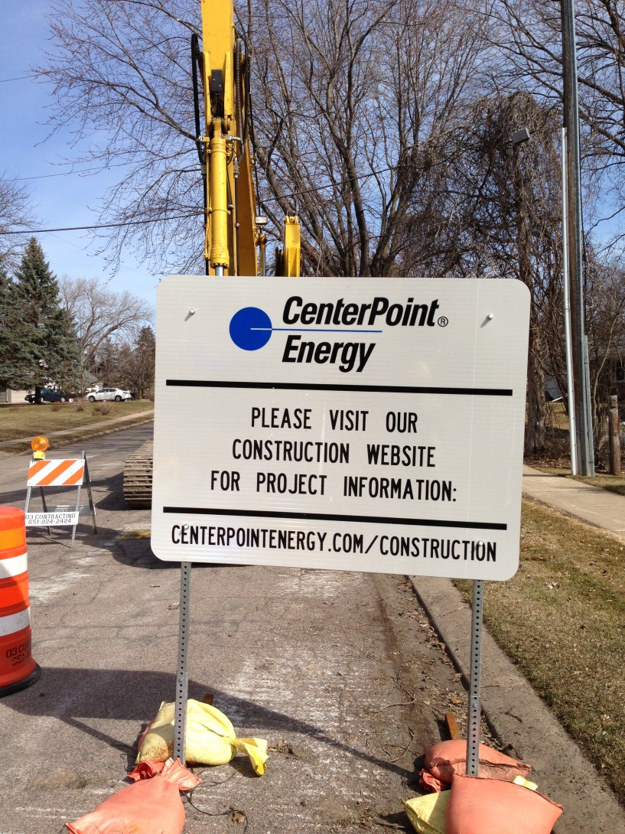
Contact information
CenterPointEnergy.com/Construction
Construction questions:
  hannah.gullickson@ centerpointenergy.com
  612-321-5546
Restoration questions:
  csv.restoration@
  centerpointenergy.com
  612-321-5477
All other questions:
  csv.constructionservices@centerpointenergy.com
  612-321-5369

Slide 8
Energy payment assistance
Low Income Home Energy Assistance Program (LIHEAP)
    Grants up to $2,000 per household
    Program income guidelines based on 60% of MN median income
    Apply via the Department of Commerce website: www.mn.gov/commerce
CenterPoint Energy Gas Affordability Program (GAP)
    Customers receiving LIHEAP funds may also be eligible for GAP assistance
    Monthly natural gas payments will not exceed 3% of income
    Apply by calling 612-372-4727
Salvation Army HeatShare Program
    Emergency Assistance for income eligible customers facing utility disconnection
    Income criteria based on 50% of MN median income
    Apply by calling 651-746-3400

Slide 9
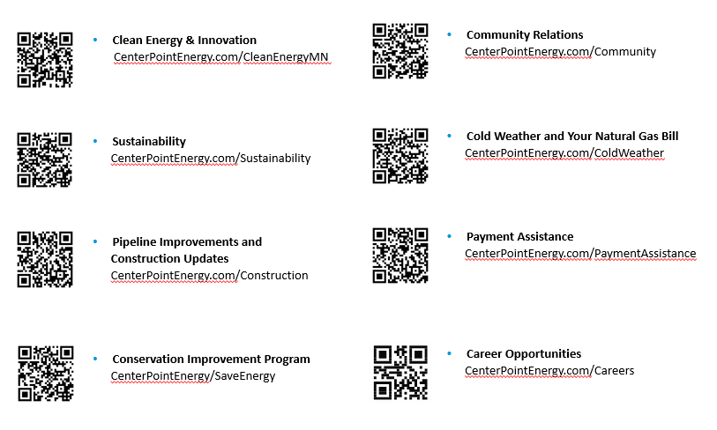
One-click resource links

