Slide 1
CenterPoint Energy 2022 Construction Activity
Focusing on our core utility businesses
Hannah Gullickson
Eden Prairie – Edenbrook Conservation Area Neighborhood
March 24, 2022

Slide 2
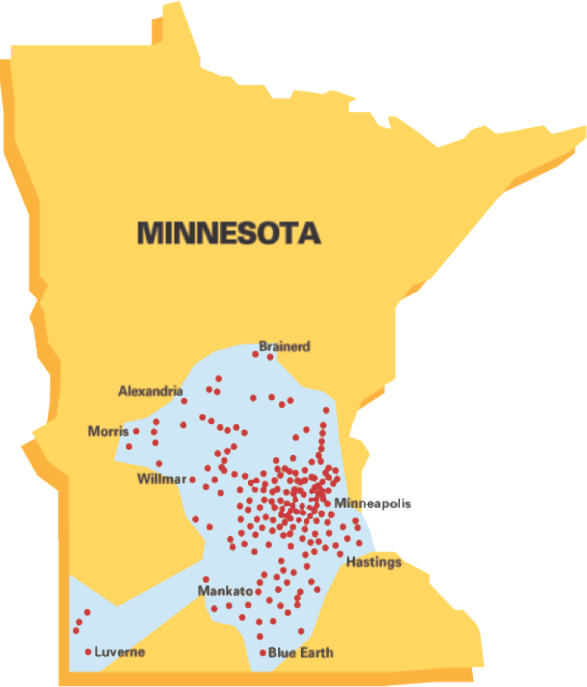
Serving Minnesota Since 1870
Founded in 1870
Serving 900,000+ customers
1,200 employees
Invested $1.7 billion in infrastructure since 2013, with plans to invest additional $1 billion in next 5 years
14,000 miles of pipeline

Slide 3
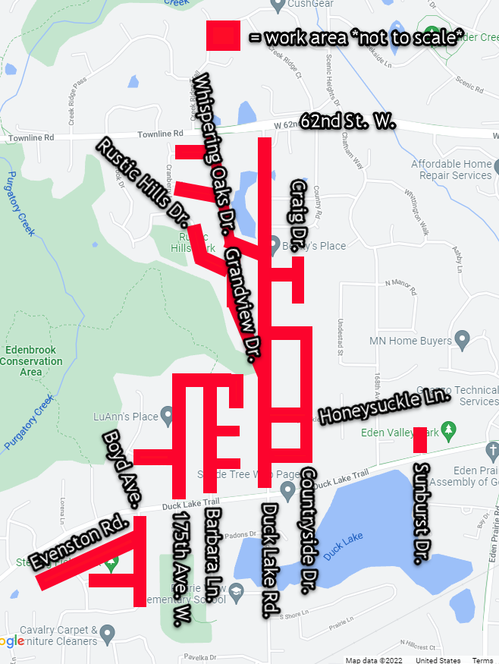
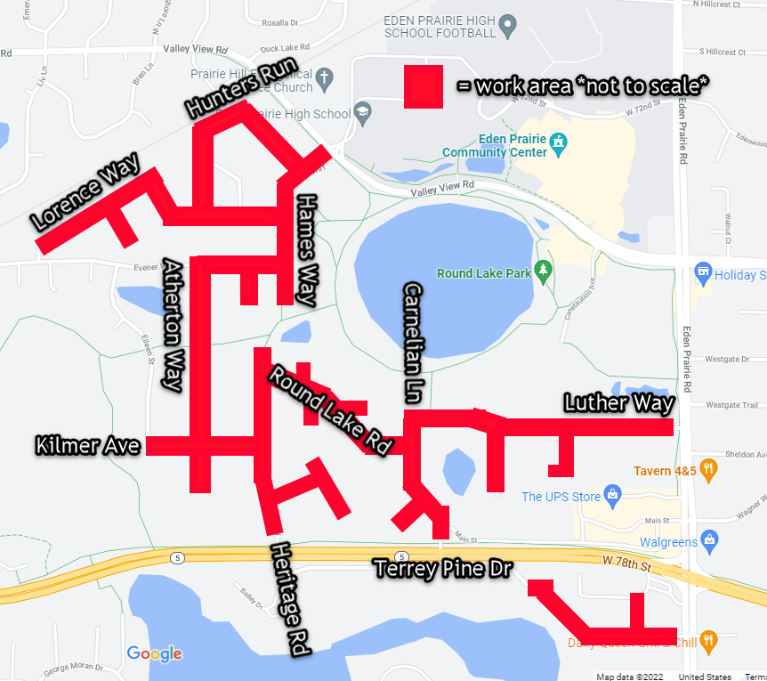
Edenbrook Conservation Area Neighborhood

Slide 4
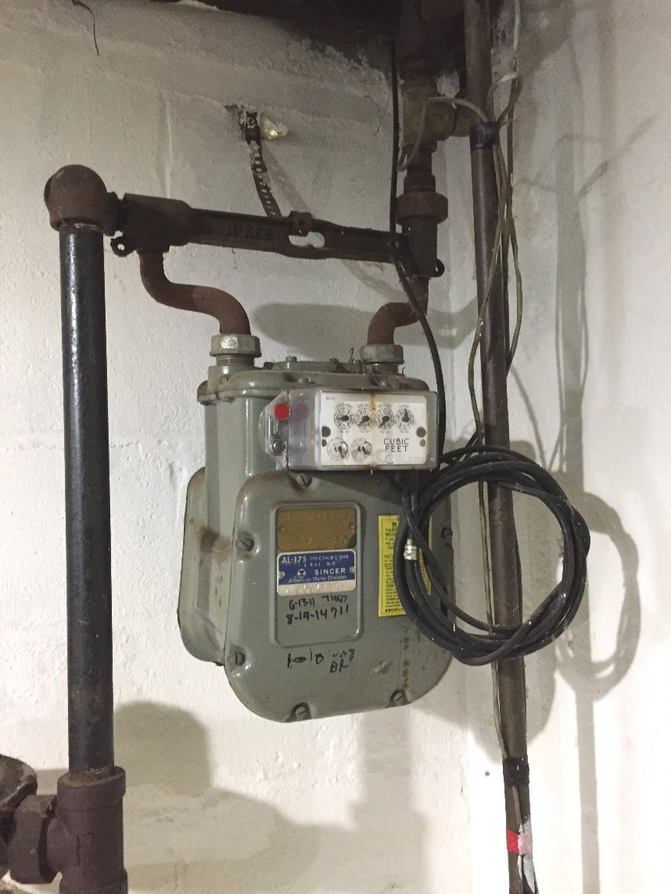
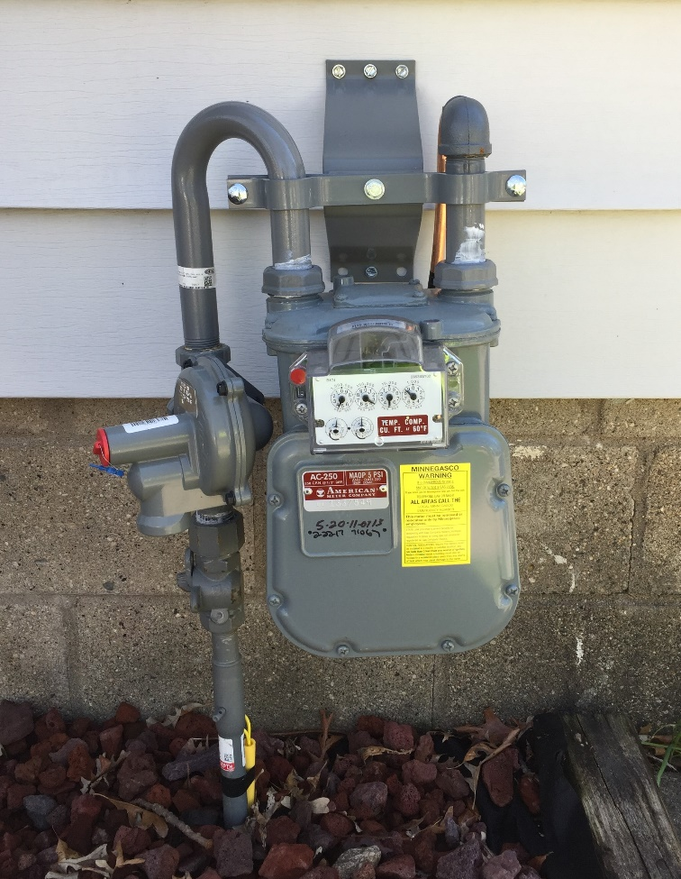
Moving gas meters to the outside of homes

Slide 5
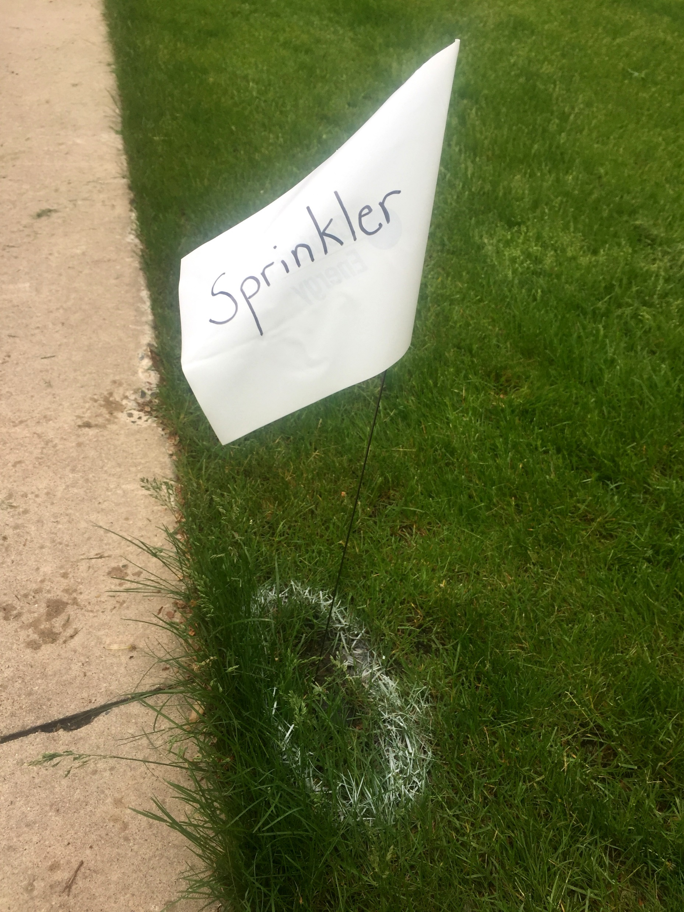
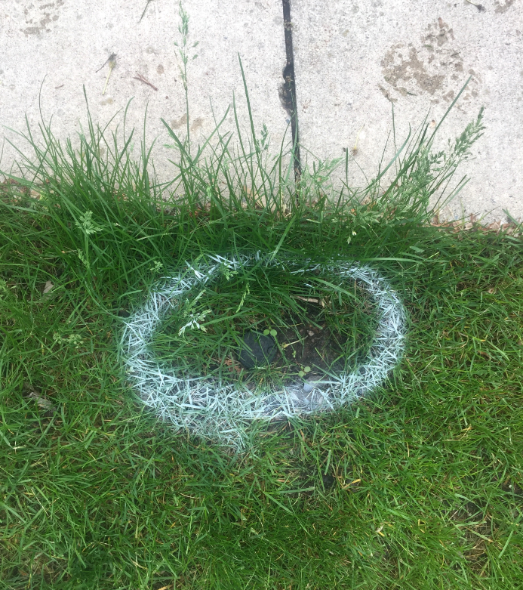
Marking privately-installed utilities

Slide 6


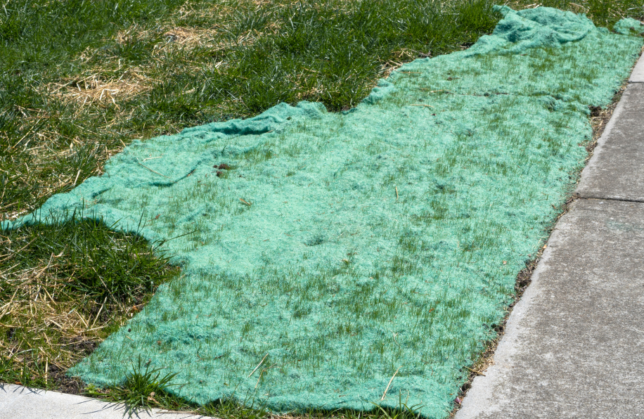
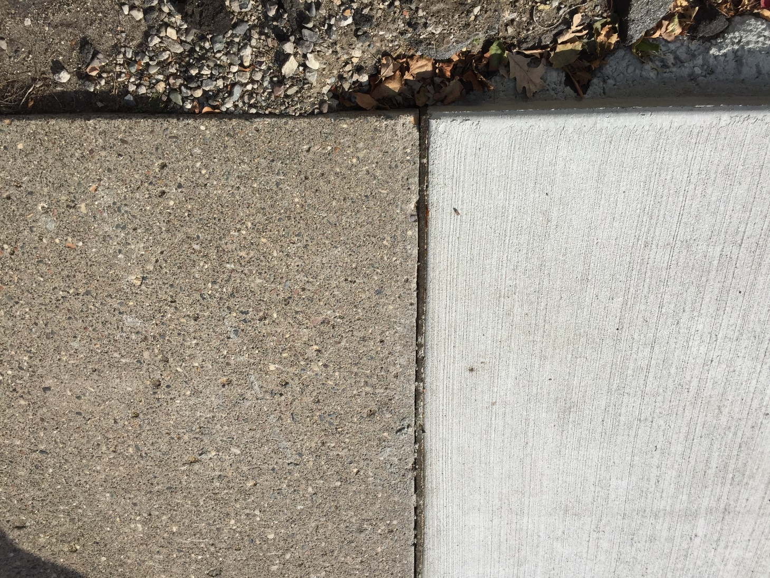
Restoration
Lawns and Boulevards
Roads and Sidewalks

Slide 7
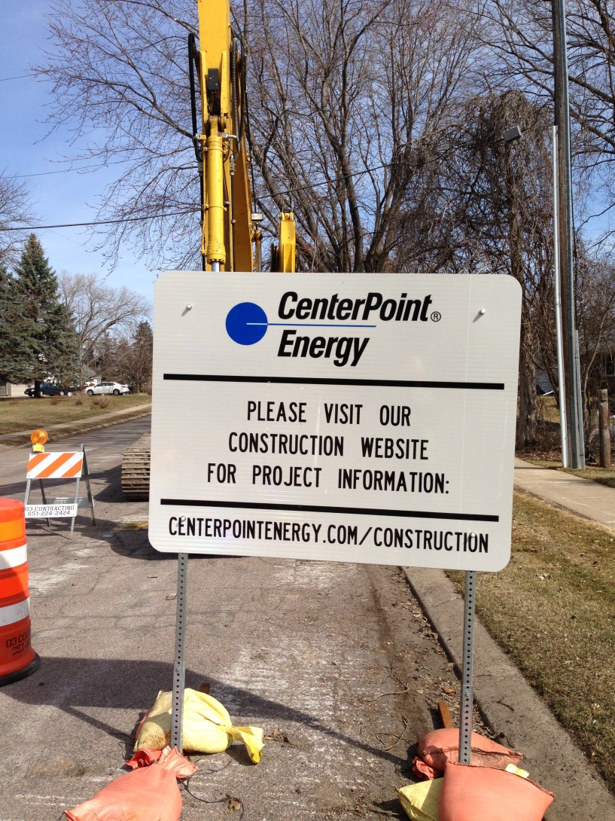
Construction Communications
CenterPointEnergy.com/Construction
Construction questions:
Hannah.gullickson@
CenterPointEnergy.com
612-321-5546
Restoration questions:
csv.restoration@
CenterPointEnergy.com
612-321-5477
All other questions:
csv.constructionservices@
CenterPointEnergy.com
612-321-5369

Slide 8
Help with your natural gas bill Energy payment assistance
Low Income Home Energy Assistance Program (LIHEAP)
Grants up to $2,000 per household
Program income guidelines based on 60% of MN median income
Apply via the Department of Commerce website: www.mn.gov/commerce
CenterPoint Energy Gas Affordability Program (GAP)
Customers receiving LIHEAP funds may also be eligible for GAP assistance
Monthly natural gas payments will not exceed 3% of income
Apply by calling 612-372-4727
Salvation Army HeatShare Program
Emergency Assistance for income eligible customers facing utility disconnection
Income criteria based on 50% of MN median income
Apply by calling 651-746-3400

Slide 9


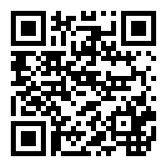
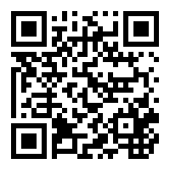
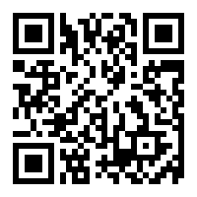
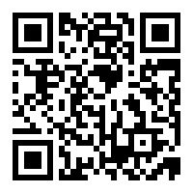
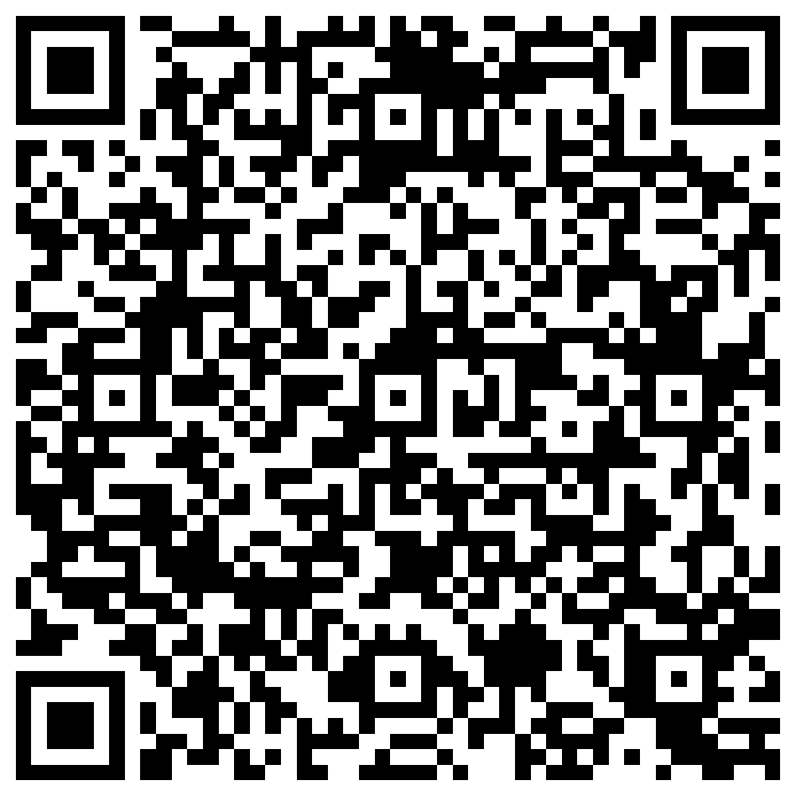

One-click resource links
Community Relations
CenterPointEnergy.com/Community
Cold Weather and Your Natural Gas Bill
CenterPointEnergy.com/ColdWeather
Payment Assistance
CenterPointEnergy.com/PaymentAssistance
Career Opportunities
CenterPointEnergy.com/Careers
Clean Energy & Innovation
CenterPointEnergy.com/CleanEnergyMN
Sustainability
CenterPointEnergy.com/Sustainability
Pipeline Improvements and Construction Updates
CenterPointEnergy.com/Construction
Conservation Improvement Program
CenterPointEnergy.com/SaveEnergy

Slide 10
Questions & Answers

