Slide 1
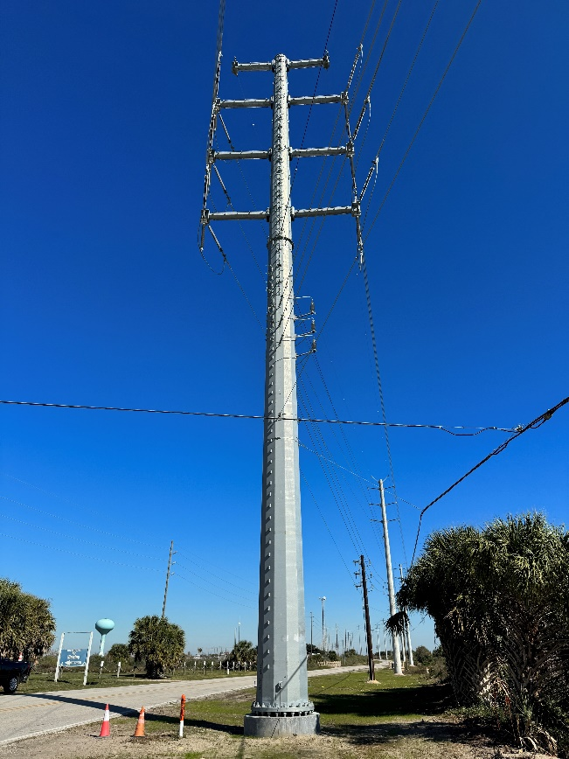
Typical 138 kV Construction Double-Circuit Steel Pole Road Right-of-Way
Temporary Easement used During Construction
Permanent Easement after Construction

