Slide 1
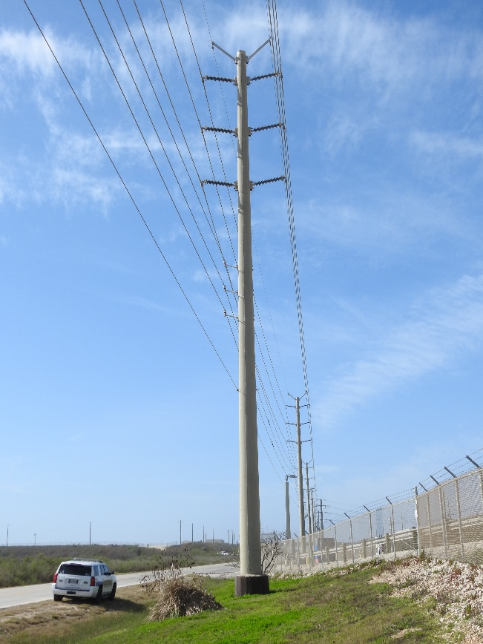
Typical 138 kV Construction
Double-Circuit Concrete Pole
Road Right-of-Way
Temporary Easement used During Construction
Permanent Easement after Construction

